Slide 1
The Employee Attendance and Payroll System Application
Jaiden Wolete, Dr.Loubna Dali, COSC 112, 12/13/2024

Slide 2
Description of Program
Tracking employee attendance, figuring out working hours, and producing payroll are all made easier and more automated with the help of the Employee Attendance and Payroll System. This system attempts to solve the difficulties that many businesses encounter when it comes to accurately calculating salaries, managing employee attendance by hand, and generating timely reports for payroll processing.
Problem it solves:
Complex Calculations of Payroll
Lack of Analytics & Reporting
Time-Consuming Process
Key Features of the App:
Check-in/Check-out times
Working Hours
Salary Compute
Payroll Generation

Slide 3
Key Challenges
Some key challenges I faced during this project were trying to find how to add the right and proper arrays to the code and also initializing the variables in order for the calculations to work. I solved them by going over some of my notes, the powerpoint lectures from class and watching youtube tutorials which made the coding a little bit more easier than it was when I started the project.

Slide 4
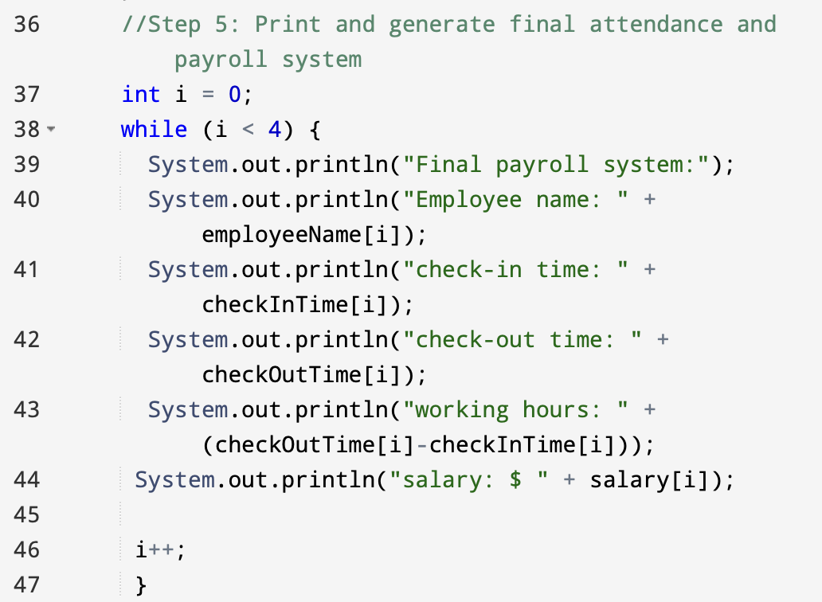
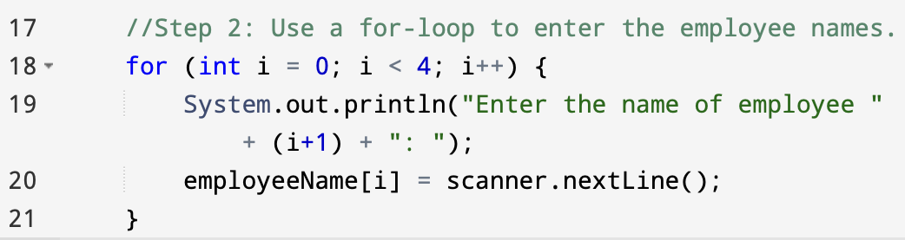
The Code Main Highlights
Below are some main key code parts and descriptions of how they work:
This part of the code is using a for-loop to enter and collect the names of employees the user entered. It runs 4 times with each iteration prompting the user to enter the name of the employee. Then it will be stored. At the end of the loop, the array will contain the names of all 4 employees entered by the user.
The final payroll system for employees is generated and printed by this section of the code. It iterates over a set of employee data stored in arrays using a while loop, printing each employee's name, check-in and check-out times, working hours, and pay. The loop prints the data for one employee first, then increases index I to process the data for the next employee, and so on, until all four employees' data is printed.

Slide 5

Video Demo of Running the Code

Slide 6
Lessons I Gained & Learned
Though this project was a challenge overall, some of the main lessons I learned from this are:
To take your time on coding and never rush it because you can make so many mistakes that you yourself won’t even realize it.
Learning how to report generation and using proper formatting in code.
Gaining variable insights into how varieties of systems could be used to streamline business processes.
Learning how and when to use for and while-loops.

Slide 7
Future Improvements
In the future, some ways I can expand or improve this project is by adding more attendance features to the code, making it more likely advanced.
Examples:
Implementing a Java system to manage the employees time off work (such as holidays, family emergency, vacation days, sick leave, etc).
Management of shifts (Morning, Evening, Afternoon, Overtime). I can implement a Java system shift module if the 4 employees work in different shifts. To do that, I just have to assign them a certain shift first.
Add calculation of overtime pay if employee is working an overtime shift plus the shift he or she is currently doing.
Use database transactions.

Slide 8
Conclusion
To wrap it all up, the basic goal of my project is to create and put into place a thorough system for managing payroll processing and tracking employee attendance. This system will assist businesses in automating salary computation, calculating working hours, and streamlining employee attendance monitoring, all while guaranteeing accurate payroll reports and adherence to corporate policies.
What I accomplished:
A good understanding of what arrays do in code and how they stored the information.
A good understanding of for-loops and writing the proper statements.
A good understanding of while-loops and writing the proper statements.
A successful code with absolutely NO errors.

